Slide 1



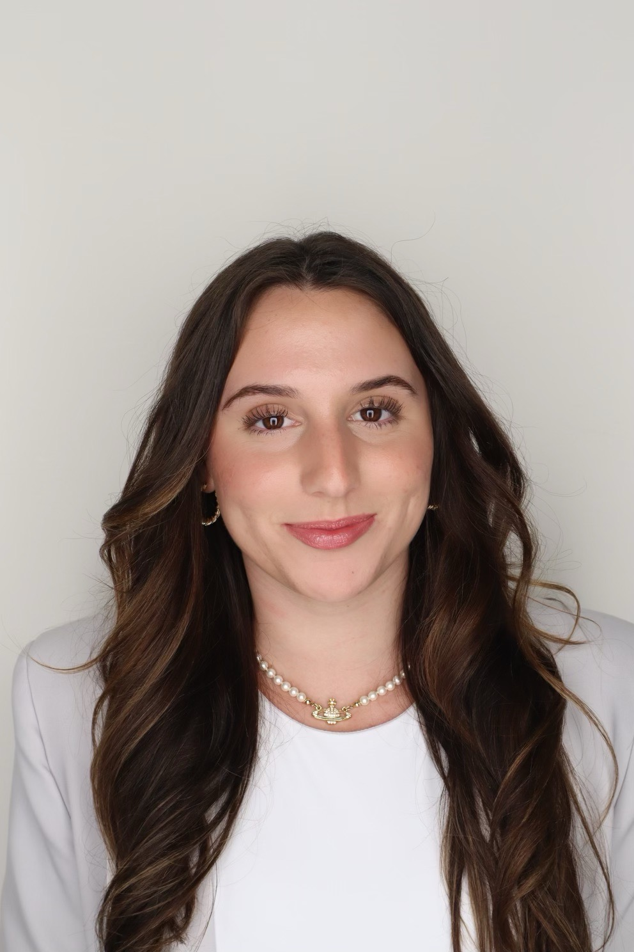
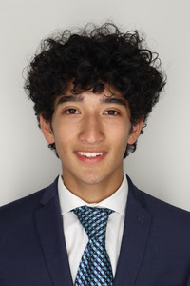
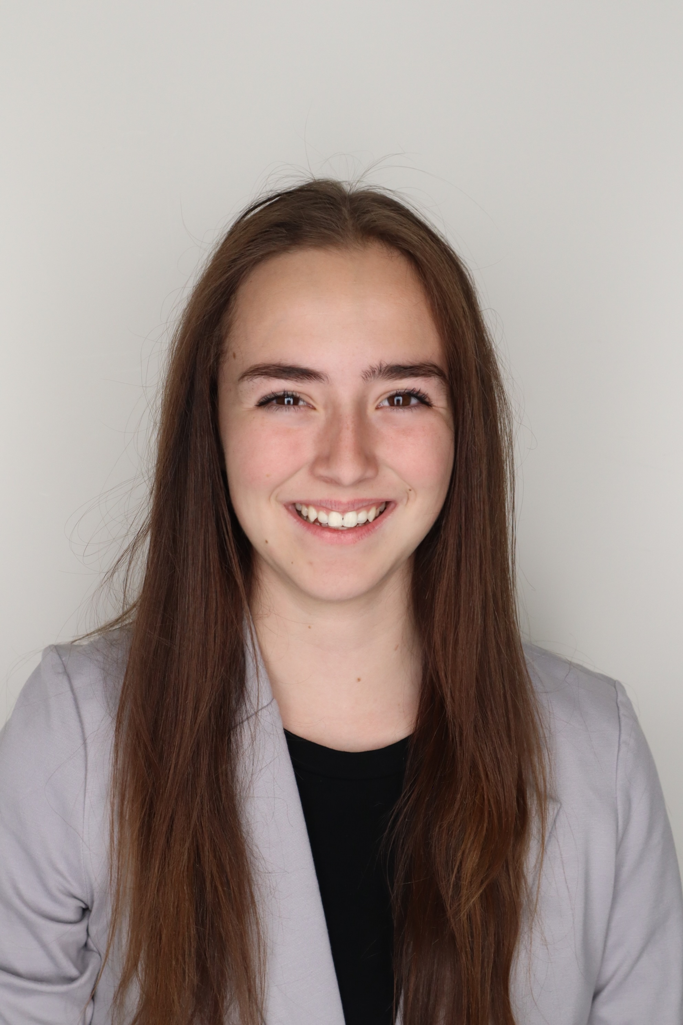

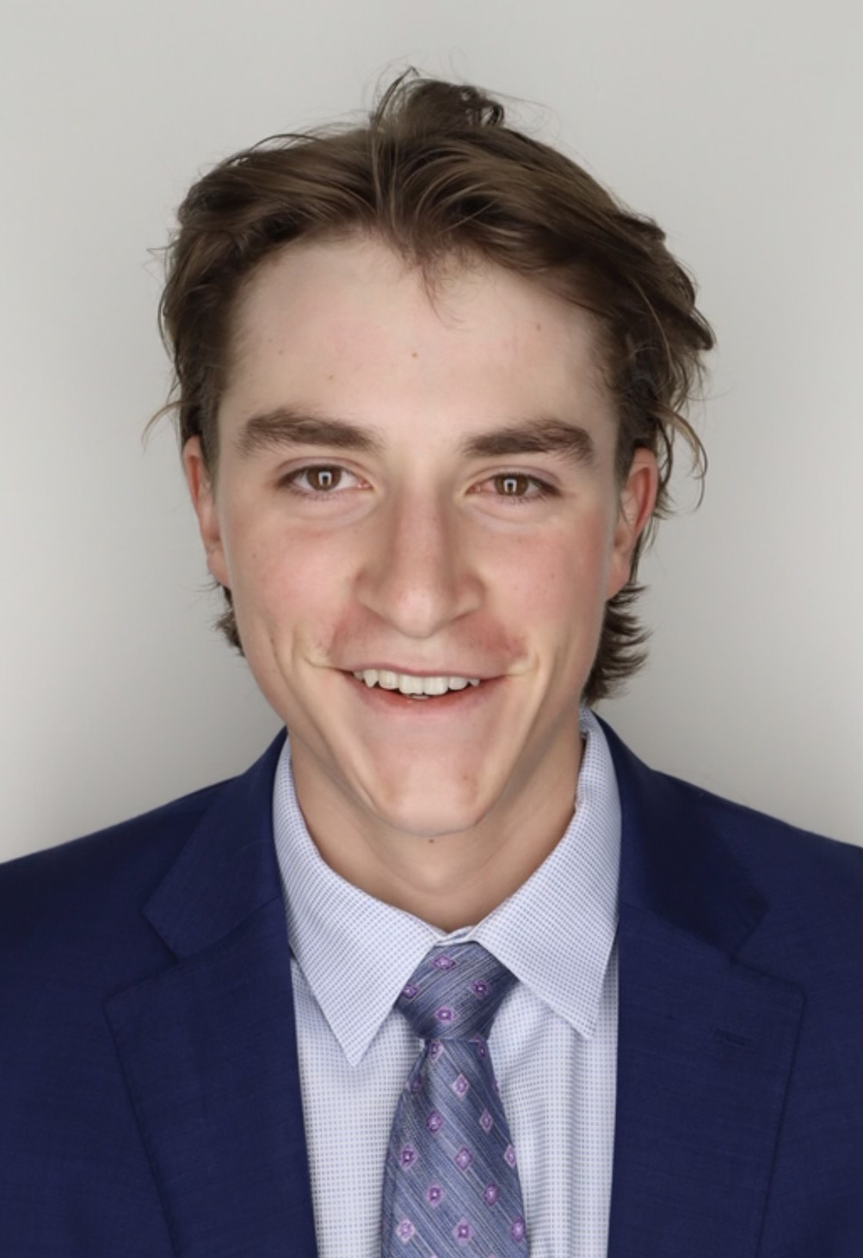
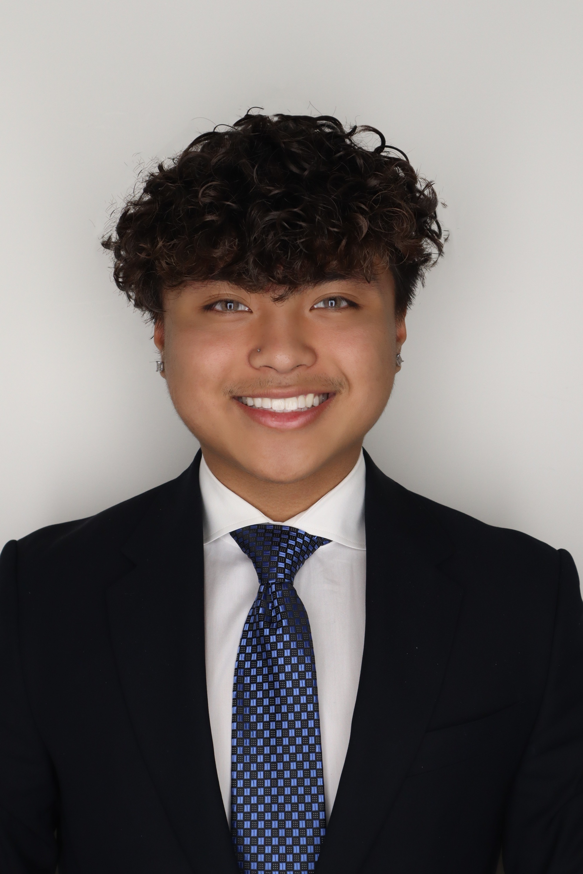
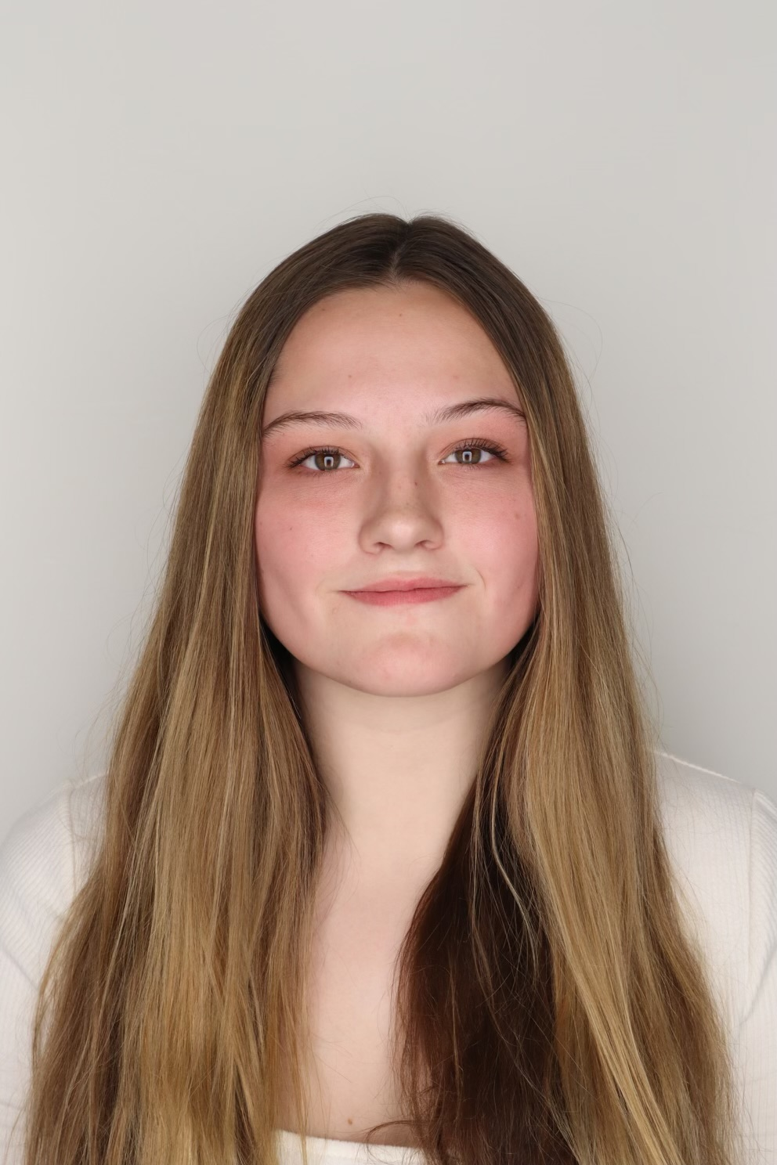



Our Consultants
Brooke DeGraan
Max Aronheim
Olivia Loder
Ryan Markus
Jason Vu
Kennedy Willig

Slide 2


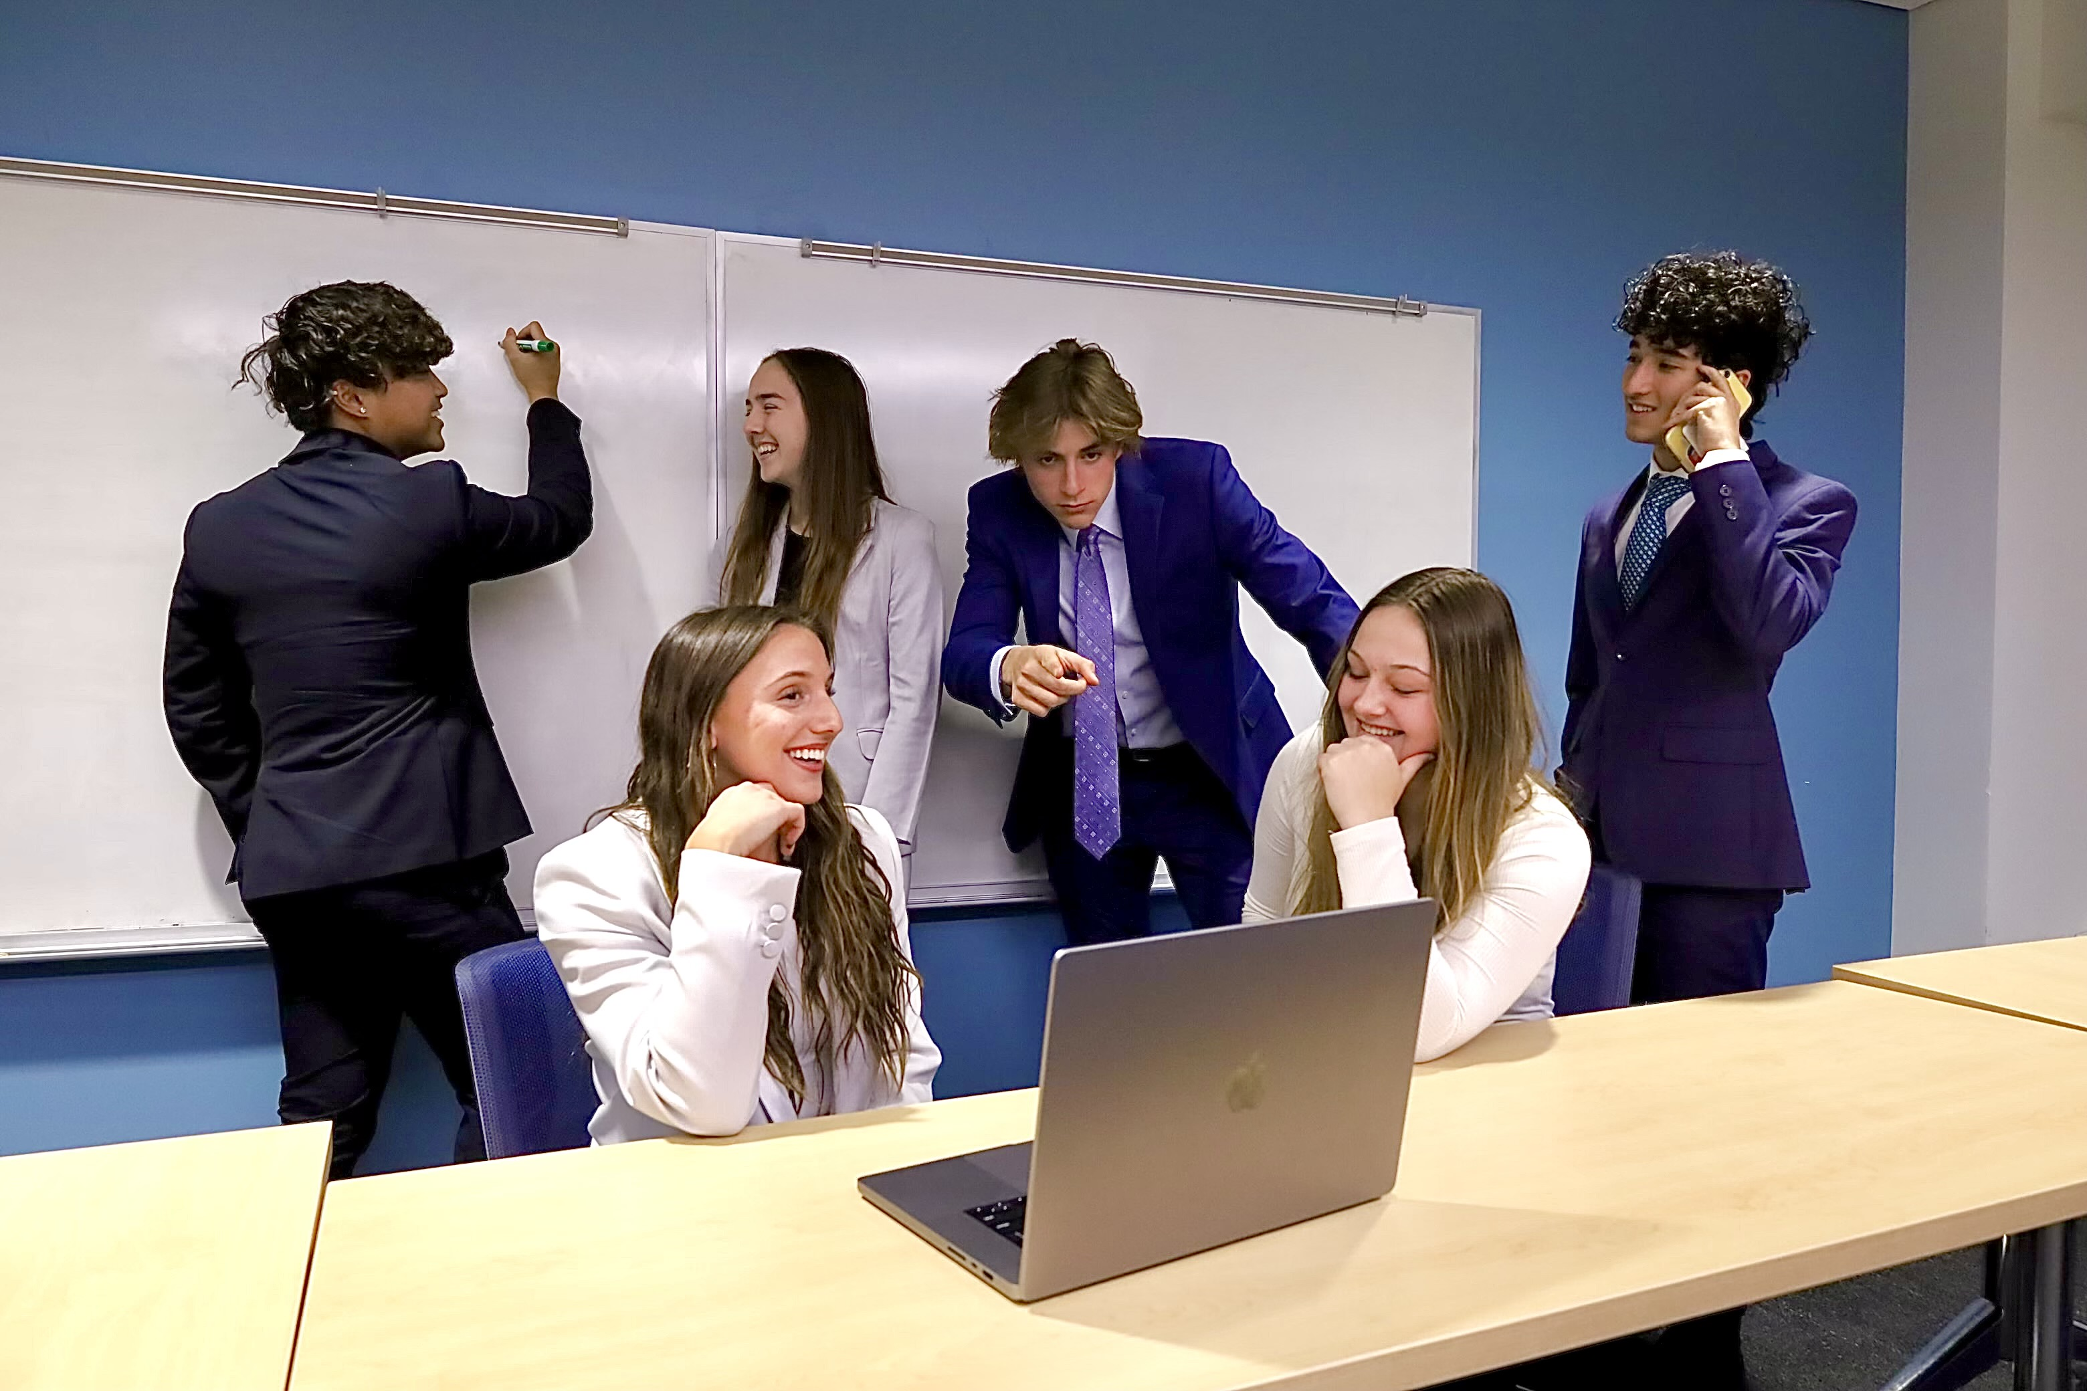


We Interviewed
Our Consultants
Brooke DeGraan
Max Aronheim
Olivia Loder
Ryan Markus
Jason Vu
Kennedy Willig

Slide 3

We Interviewed
The Challenges
Our Consultants
Target Stronger Labor Markets
Plant the Seeds
Fortify Strong Work Culture
Tend the Garden
Brooke DeGraan
Max Aronheim
Olivia Loder
Ryan Markus
Jason Vu
Kennedy Willig
Notes:
Over the past 3 weeks, we sought to understand, empathize, and determine a comprehensive list of challenges within the hospitality industry. To match this informational need, we interviewed 4 individuals with vastly different work experiences within hospitality. We talked to Patty, a new front desk associate at Boulderaldo with a unique “front-line” associate perspective. Nicole Dahl, an outstanding Task Force manager, shared with us some managerial-side wisdom and opened our eyes to the multi-faceted challenges in team execution. Finally, we got an exclusive interview with Randy Morton, the long-time President and COO of the Bellagio Hotel and Casino in fabulous Las Vegas. He was instrumental in stressing the importance of building from within, and establishing a positivity based culture where associates and managers alike look forward to delivering a fantastic guest experience. Using these first person accounts, Kennedy’s going to brief you on the Omni-Interlocken specific opportunities to grow.

Slide 4
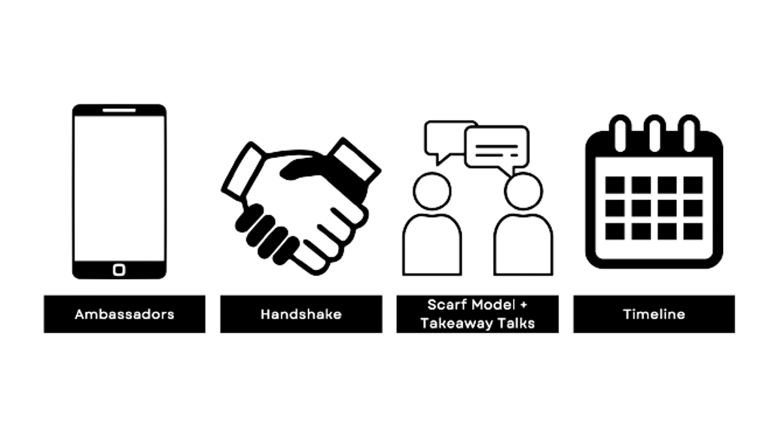
The Challenges:
We Interviewed
The Solutions:
Target Stronger Labor Markets
Plant the Seeds
Fortify Strong Work Culture
Tend the Garden

Slide 5
Call to Arms
Glamorize Your Garden
Implementation
The Challenges
The Solutions:
Target Stronger Labor Markets
Plant the Seeds
Fortify Strong Work Culture
Tend the Garden
Food, beverage, & housekeeping

Slide 6
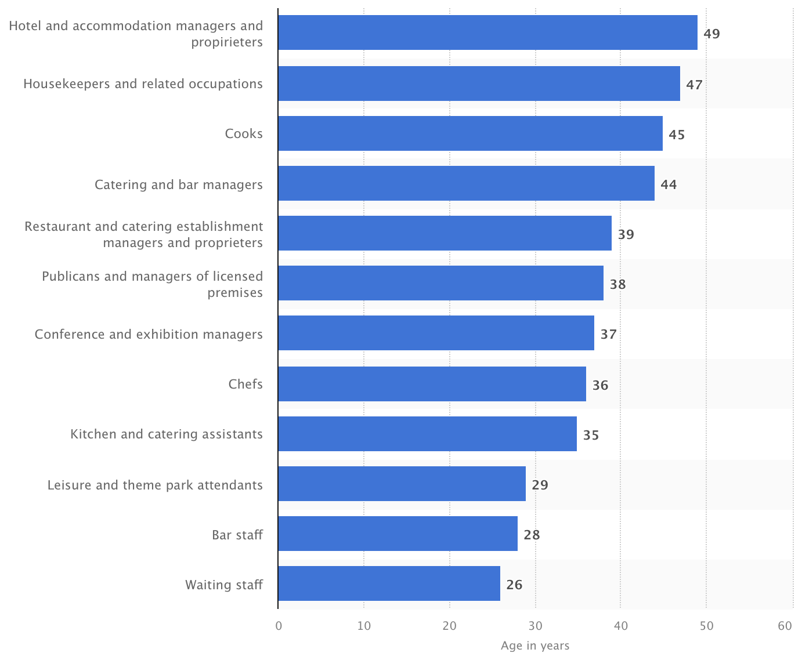
The Solutions:
Food, beverage, & housekeeping

Slide 7
An Argument On Age
Food, beverage, & housekeeping

Slide 8
Capitalize off younger labor markets
5/6 of our interviewed management started at 17 to 21 years age
Schedule aligns with your busy seasons
Less financial needs
They don’t have as many financial needs
5/6. of our interviewed management started at 17 or 19 years age
They swing more with your busy seasons

Slide 9
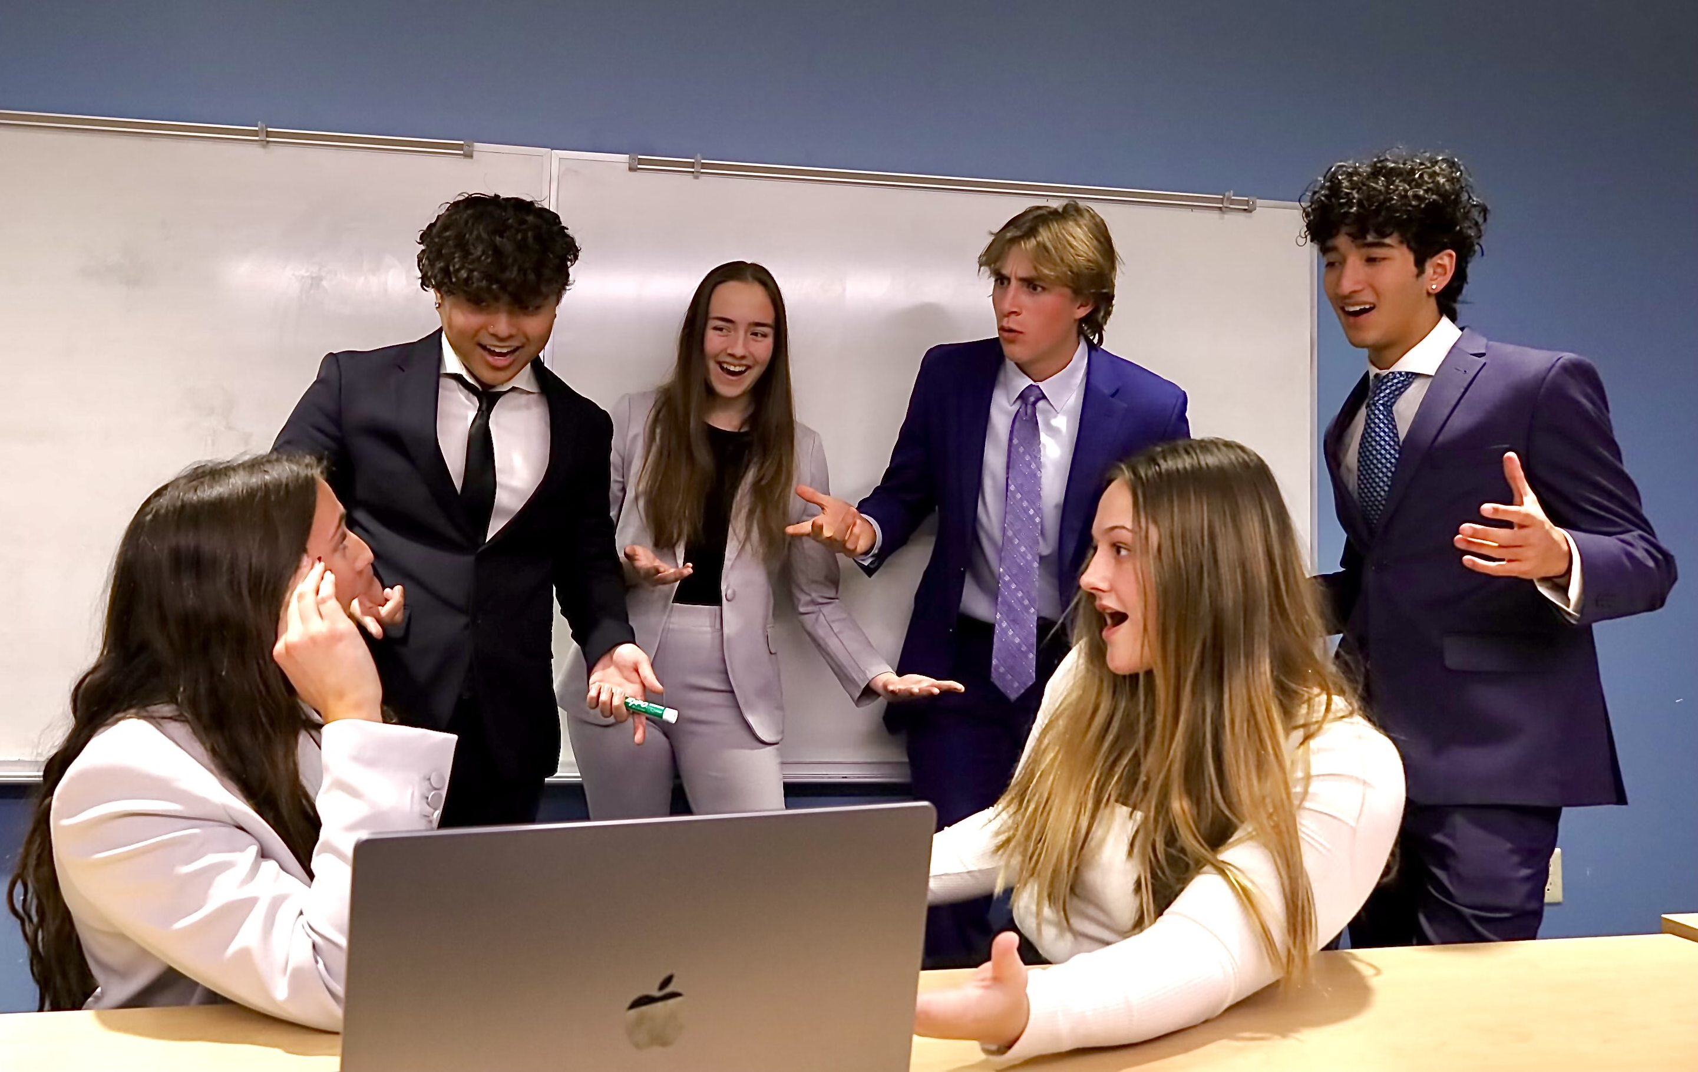
Capitalize off younger labor markets
Plant the Seeds
Doing More than Indeed
5/6 of our interviewed management started at 17 to 21 years age
Schedule aligns with your busy seasons
Less financial needs

Slide 10
Capitalize off younger labor markets
The Ambassador Setup
They help recruit, they receive commission-based rewards
They don’t have as many financial needs
5/6 of our interviewed management started at 17 or 19 years age
They swing more with your busy seasons
Plant the Seeds
Recruit A Person
Have 5 nights covered at Omni, with food
Doing More than Indeed

Slide 11
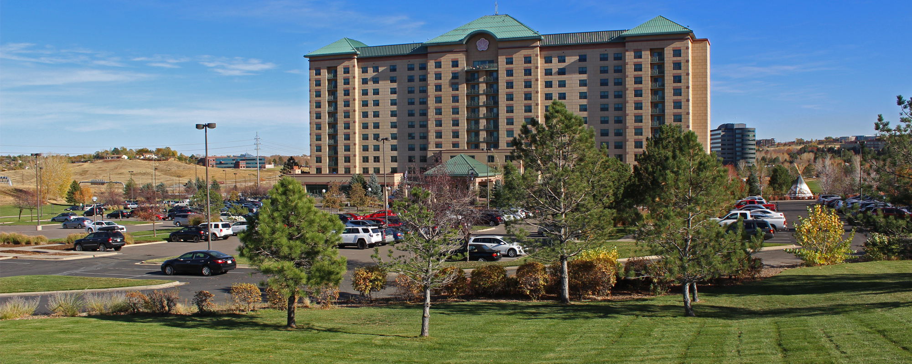
The Ambassador Setup
Plant the Seeds
Doing More than Indeed
Costs
They help recruit, they receive commission-based rewards
Recruit A Person
Have 5 nights covered at Omni, with food

Slide 12
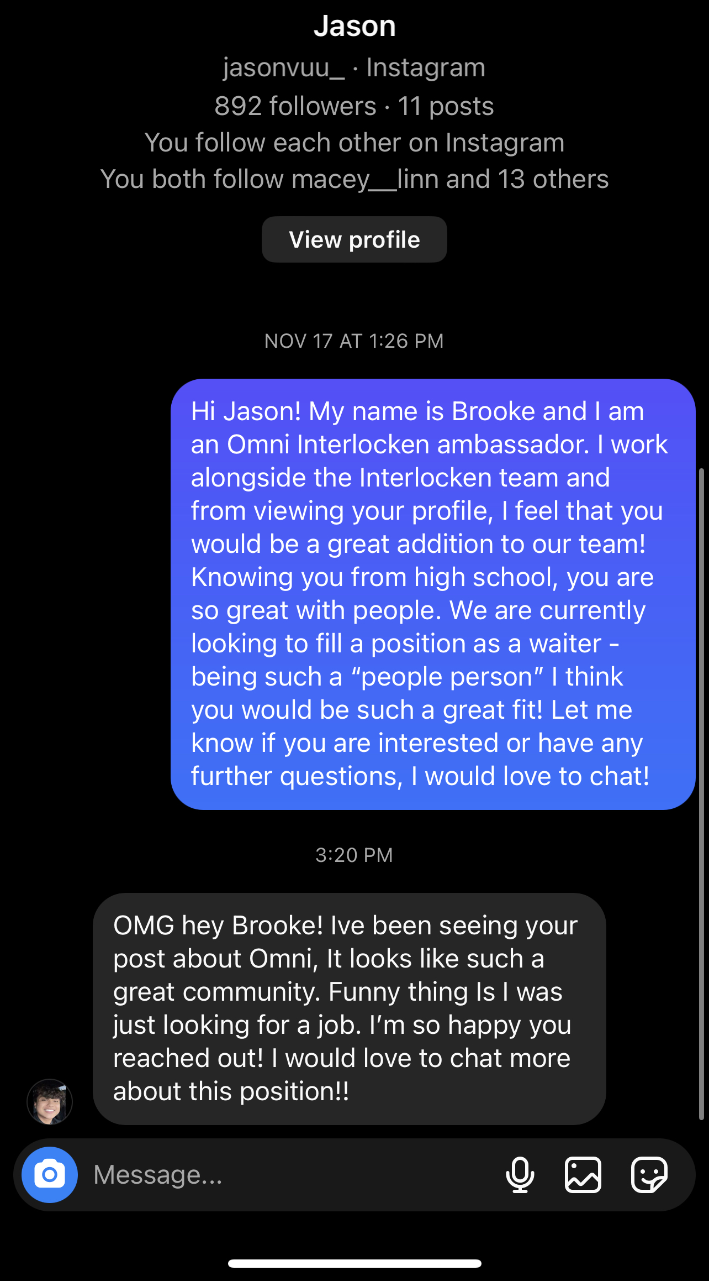

The Ambassador Setup
They help recruit, they receive commission-based rewards
Recruit A Person
Have 5 nights covered at Omni, with food

Slide 13



Ambassador’s Models
Lululemon
RedBull
Harley-Davidson
Recruit A Person
Have 5 nights covered at Omni, with food
Revenue soared to $2.64B in 2017, 500M increase
Increase of 2B cans sold in 2020
Boasting 325,000 ambassadors with perks

Slide 14
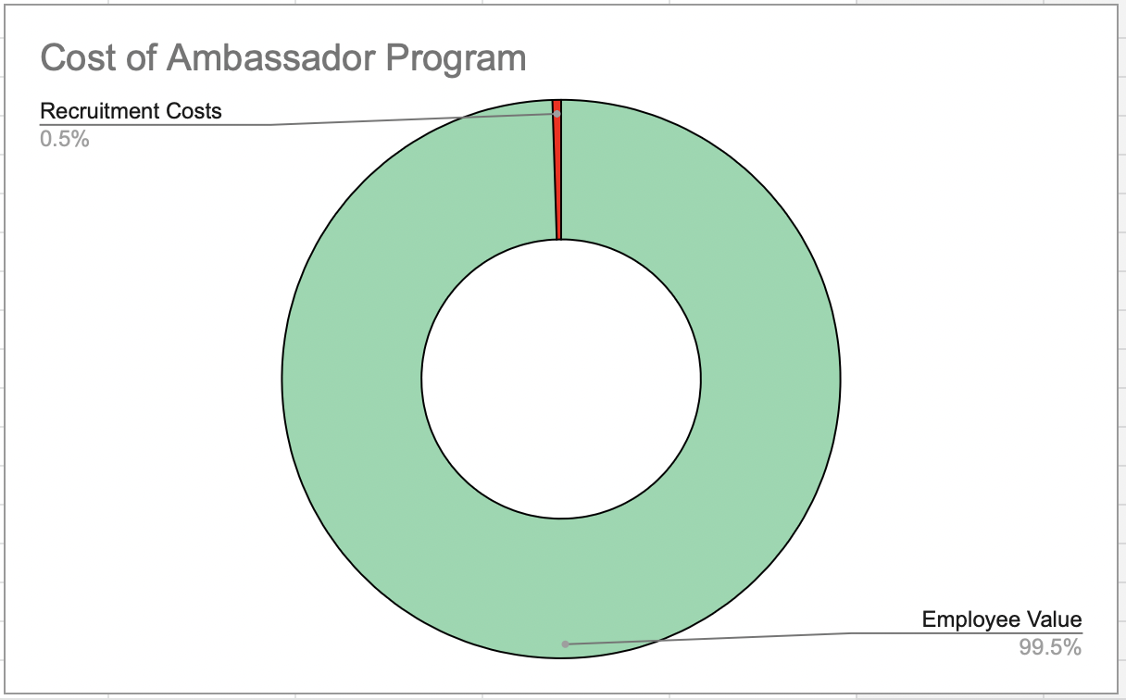
Ambassadors’ Successes
Perceived value: Omni Cost
4:1
Costs
Lululemon
RedBull
Harley-Davidson
Revenue soared to $2.64B in 2017, 500M increase
Increase of 2B cans sold in 2020
Boasting 325,000 ambassadors with perks

Slide 15

Ambassadors’ Successes
Indeed is passive recruitment
Handshake actively recruits people virtually & in-person
Avg. Var. Cost:
$248/recruit
Perceived value: Omni Cost
4:1
Lululemon
RedBull
Harley-Davidson
Revenue soared to $2.64B in 2017, 500M increase
Increase of 2B cans sold in 2020
Boasting 325,000 ambassadors with perks

Slide 16
How Cheap it is
Avg. Var. Cost:
$248/recruit
Perceived value: Omni Cost
4:1
Unlike Indeed Handshake targets younger demographics
Indeed is passive recruitment
Perceived value: Omni Cost
4:1
Indeed:
Demographic is ages 25-34
Handshake
Hosts events through colleges
Handshake actively recruits people virtually & in-person

Slide 17

Unlike Indeed, Handshake targets younger demographics
Indeed is passive recruitment
Handshake actively recruits people virtually & in-person
Has 1400 university partnerships
Used by +10M students
Even used by current competitors like Marriot
It’s free
Indeed:
Demographic is ages 25-34
Handshake
Hosts events through colleges

Slide 18
Unlike Indeed Handshake targets younger demographics
Target Stronger Labor Markets
Plant the Seeds
Fortify Strong Work Culture
Tend the Garden
1400 university partnerships
Used by +10M students
Competitors: Marriott, Hilton
Free
Indeed:
Demographic is ages 25-34
Handshake
Hosts events through colleges

Slide 19
The Challenges:
Tend the Garden
SCARF / Takeaway Talks
SCARF / Takeaway Talks
Target Stronger Labor Markets
Plant the Seeds
Fortify Strong Work Culture
Tend the Garden
1400 university partnerships
Used by +10M students
Competitors: Marriott, Hilton
Free

Slide 20
The Challenges:
You’re Doing Great!
The SCARF Model
Target Stronger Labor Markets
Plant the Seeds
Fortify Strong Work Culture
Tend the Garden
Tend the Garden
Status
Certainty
Autonomy
Relatedness
Fairness
-58% in group perception
SCARF / Takeaway Talks

Slide 21
You’re Doing Great!
Tend the Garden
SCARF / Takeaway Talks
The SCARF Model
Meeting weekly with employees
Surprise & Delights
Readjusting server wages
Status
Certainty
Autonomy
Relatedness
Fairness
-58% in group perception

Slide 22
You’re Doing Great!
Tend the Garden
SCARF / Takeaway Talks
Do with GLAMOUR
The SCARF Model
Status
Certainty
Autonomy
Relatedness
Fairness
Meeting weekly with employees
Surprise & Delights
Readjusting server wages
-58% in group perception

Slide 23

Takeaway Talks
Quarterly surveys received only a 46% response rate
You’re Doing Great!
The SCARF Model
Status
Certainty
Autonomy
Relatedness
Fairness
Meeting weekly with employees
Surprise & Delights
Readjusting server wages
Do with GLAMOUR
-58% in group perception

Slide 24
Takeaway Talks
Closing Duties
Management posts new practices based off feedback
3 employees takeaway
Employees become vulnerable
Management asks questions
Do with GLAMOUR
Do with GLAMOUR
What did you love about today
What can I do to support you the next time you come in?
Consistent!
Faster, more reliable feedback
Fosters associate trust in management

Slide 25



Takeaway Talks
The Benefits:
Response rate will become 100%
Latency with internal problems will be reduced
Solidify trust, transparency, fairness, & certainty
Inexpensive
Takeaway’s Models
Takeaway Talk Breakdown
Closing Duties
Management posts new practices based off feedback
employees takeaway
Google
Cargill
Screwfix
85% increase in initiative
50% increase in care for work
73% better collaborators
40% increase in productivity
70% rise in employees feeling valued
21% higher profitability
Stronger customer engagement
Stronger retention
Employees become vulnerable
Management asks questions

Slide 26
Takeaway’s Models
Closing Duties
Management posts new practices based off feedback
3 employees takeaway
Employees become vulnerable
Management asks questions
The Solutions:
Implementation
A Self Improvement Cycle
Google
Cargill
Screwfix
85% increase in initiative
70% rise in employees feeling valued
21% higher profitability

Slide 27
Closing Duties
Management posts new practices based off feedback
3 employees takeaway
The Recap
Employees become vulnerable
Management asks questions
What Matters?
Takeaway Talk Breakdown
The Benefits:
Response rate will become 100%
Latency with internal problems will be reduced
Solidify trust, transparency, fairness, & certainty
Inexpensive
Quarterly surveys received only a 46% response rate
Do things with GREATNESS
Notes:
Takeaway talks are an incredibly tangible way to start building community. Speaking with your coworkers on a daily basis fosters positive relationships and most importantly builds trust. This enforces the mindset that co workers and managers work alongside you, not above you. When interviewing Nicole from The Hilton, she said this mindset is what helps them be the most successful. Having an open communication where your voice is heard by managers promotes transparency, fairness, and creates vital bonds. Working with a team you enjoy talking to and can trust is incredibly beneficial and FREE of CHARGE.
Takeaway talks are an incredibly tangible way to start building community. Speaking with your coworkers on a daily basis fosters positive relationships and most importantly builds trust. This enforces the mindset that co workers and managers work alongside you, not above you. When interviewing Nicole from The Hilton, she said this mindset is what helps them be the most successful. Having an open communication where your voice is heard by managers promotes transparency, fairness, and creates vital bonds. Working with a team you enjoy talking to and can trust is incredibly beneficial and FREE of CHARGE.

Slide 28
The Solutions:
The Recap
What Matters?

Slide 29

The Solutions:
The Recap
Glamorize Your Garden
What Matters?
Google
Cargill
Screwfix
85% increase in initiative
50% increase in care for work
73% better collaborators
40% increase in productivity
70% rise in employees feeling valued
21% higher profitability
Stronger customer engagement
Stronger retention

Slide 30
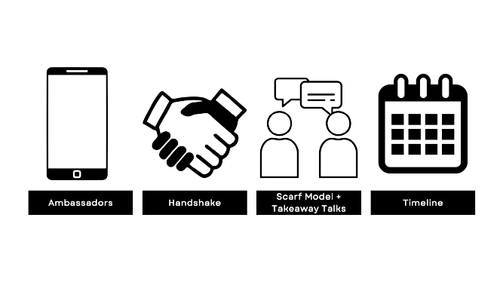
Glamorize Your Garden
The Solutions:
The Solutions:

Slide 31
We Interviewed
Glamorize Your Garden
Contact Us!
Brooke DeGraan
Max Aronheim
Olivia Loder
brooke.degraan@gmail.com
858-722-9595 Linkedin
maar5011@colorado.edu
303-859-8135 Linkedin
loder_olivia@yahoo.com
518-810-2302 Linkedin
Ryan Markus
Jason Vu
Kennedy Willig
ryanmarkus9@gmail.com
970-481-2707 Linkedin
Jasonlong.vu0919@gmail.com
720-998-4485 Linkedin
kennedyewillig@gmail.com
503-753-4280 Linkedin

Slide 32

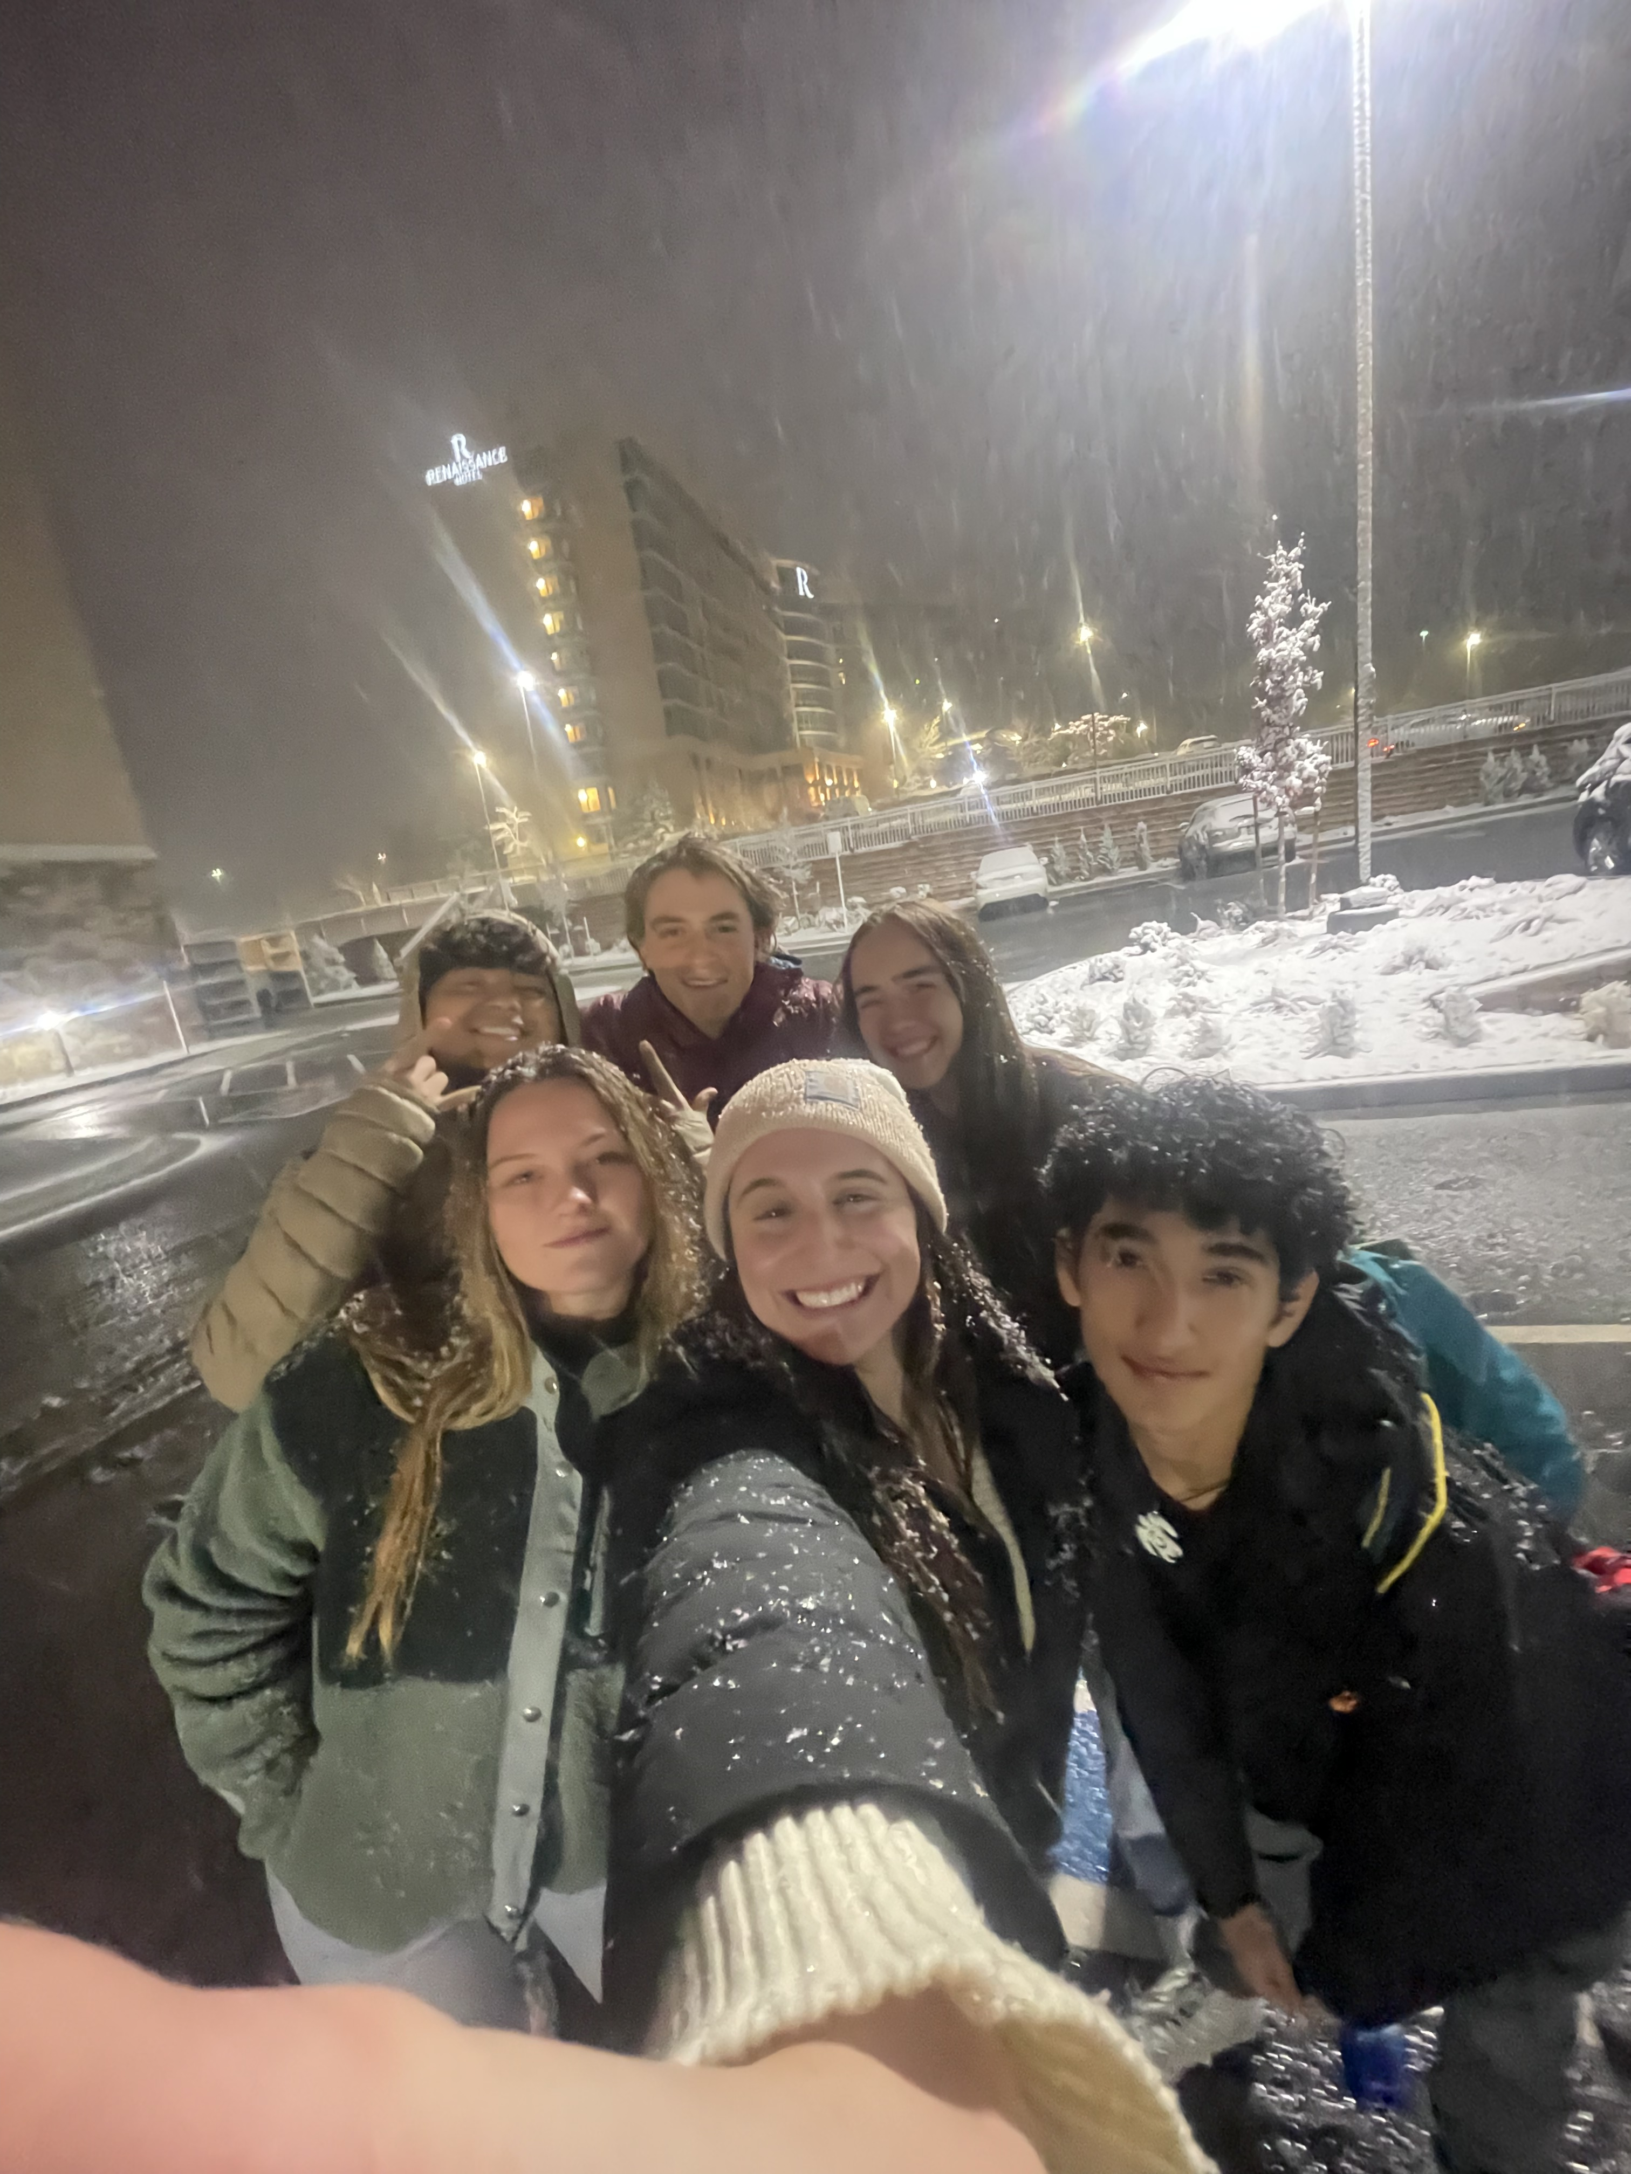
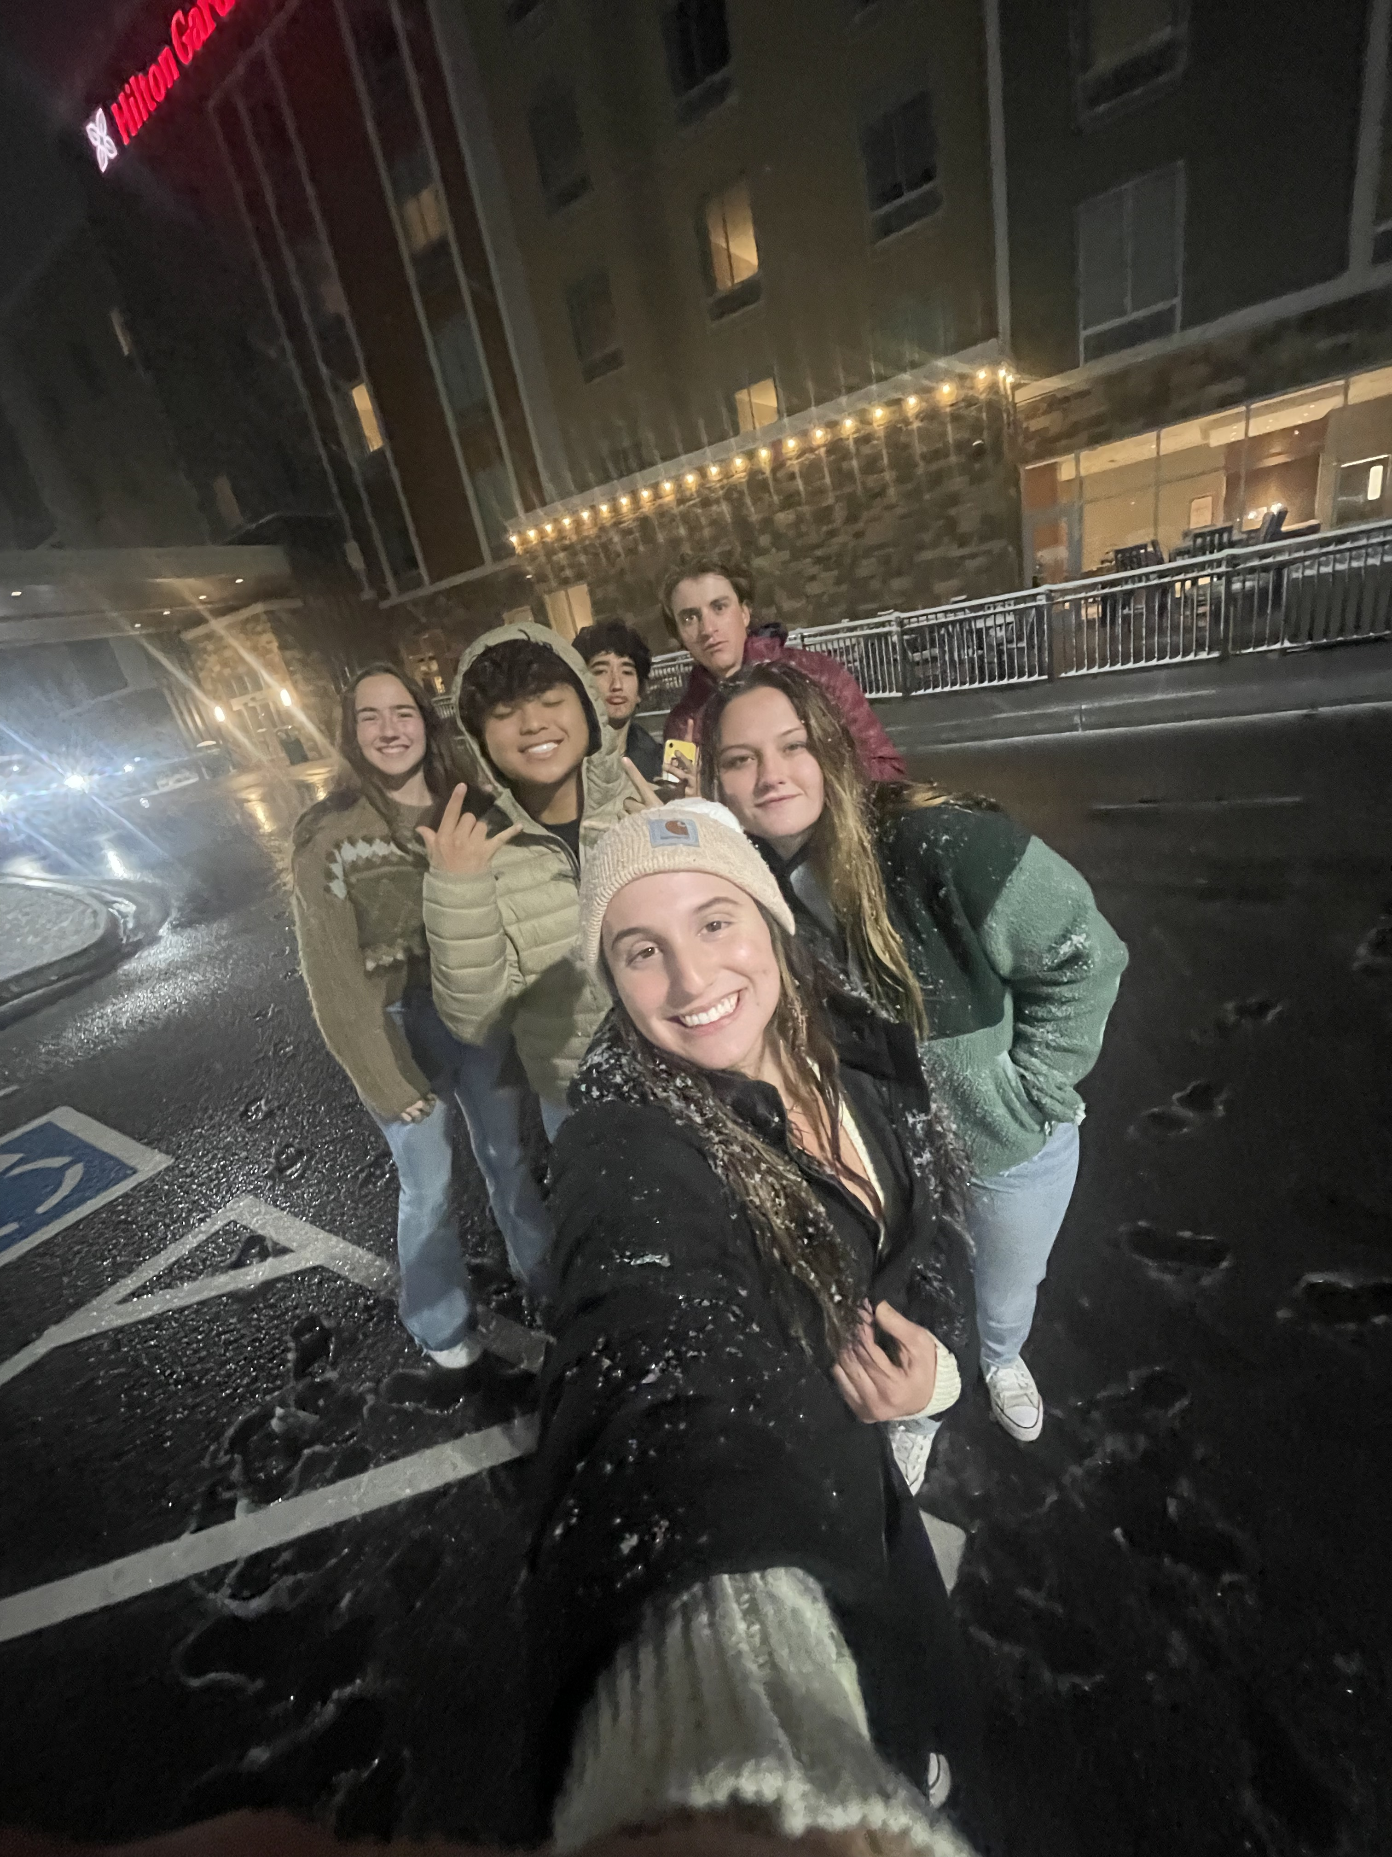




Introduction
Barriers to Entry
Planting the Seeds
Tending the Garden
Call to Arms
LFG Interviews Regent Hotels
LFG Educates Ourselves:
LFG Interviews Hilton Hotels

Slide 33
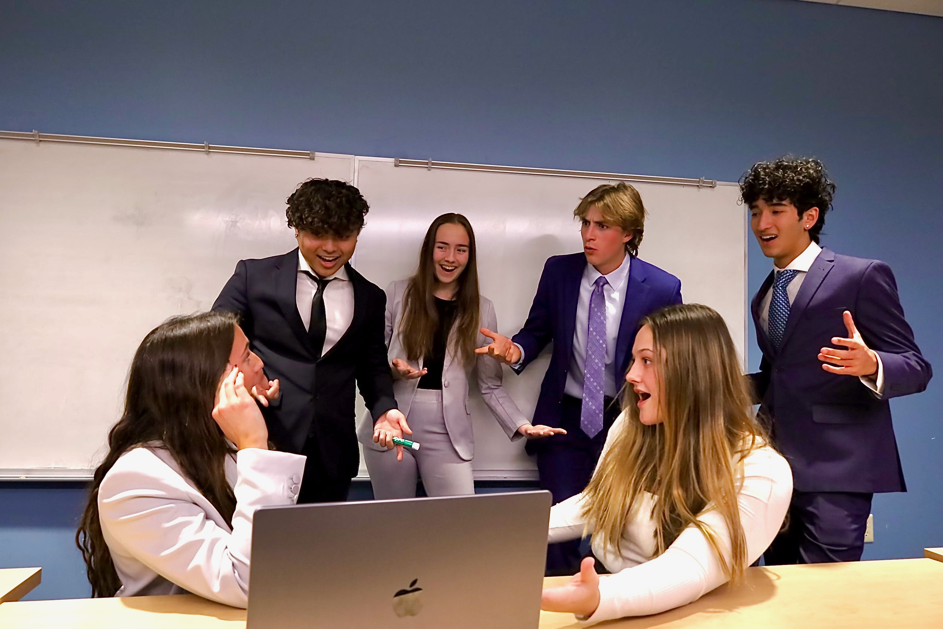
We Interviewed
LFG Educates Ourselves:
LFG Interviews Regent Hotels
LFG Interviews Hilton Hotels

Slide 34
The Back Slides
Age link for creds
List of all the interviewable people
The challenges of establishing the daily shift thing
Ambassador program timeline

